Slide 1


Predicting Movie Revenue
Credits: Brandon, Melvin, Nandini, Nishant

Slide 2


The Question
Leveraging common metadata about a film can we predict the expected revenue?

Slide 3



Usage
This model could be leveraged by production companies for making
go / no-go screening decisions.

Slide 4
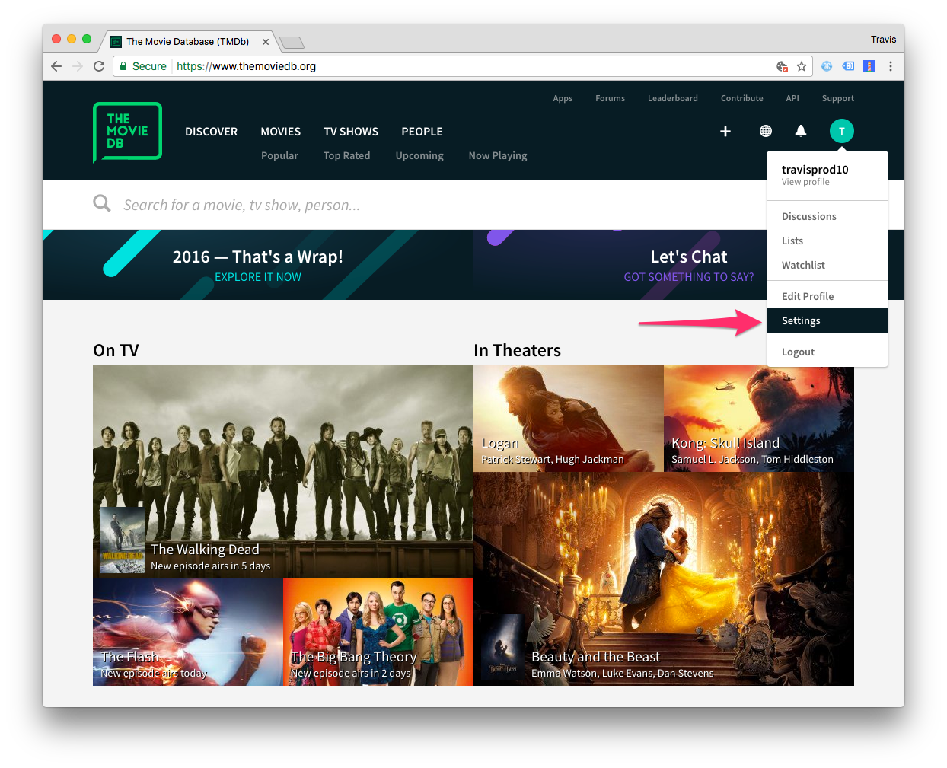
ABOUT THE DATASET

Slide 5
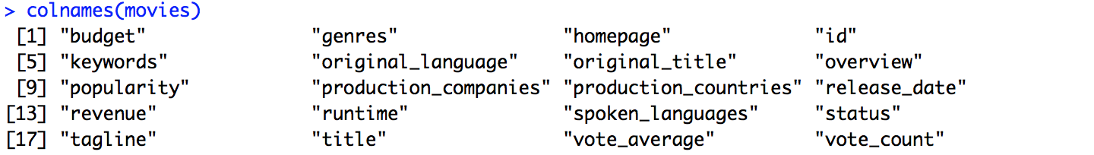
The Data Set
Source: https://www.kaggle.com/tmdb/tmdb-movie-metadata/data
Data Set contains 5000 records representing films, along with data from the credits
Fields:
Number of views on the website
Movie Rating/ IMDB score
Notes:
The dataset came in two files, each with 5000 records with one movie per line.
Credits CSV file has Cast and Crew columns
Movies dataset had:
Budget
Genres
Original Language
Popularity
Production Countries
Release date
Revenue
Runtime
Vote Average (out of 10
Vote Count

Slide 6
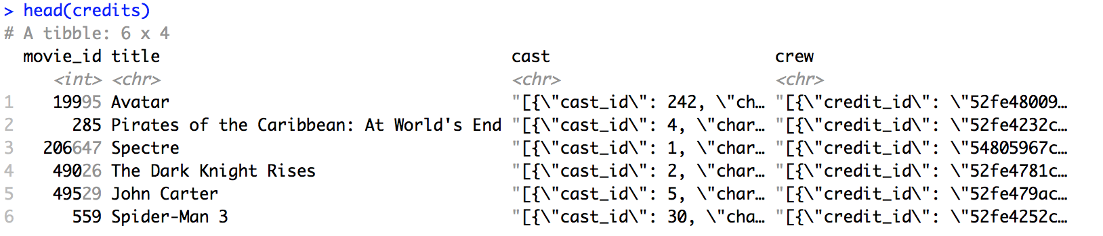
Data structure
The Movie data is straightforward, while the credits data set contains two columns of nested JSON containing the films cast and crew.

Slide 7
DATA WRANGLING

Slide 8
Clean Up Process - Movies Data Set
Remove NA values & rows missing data
Normalize release_date into “Holiday”
Normalize into English & USA
Enumerate distinct genres
Break out keywords
1
2
3
4
5
Notes:
Remove lines with NA values
Take only months of release date and categorize into “holiday” month binary
Count number of languages in each movie
Binary column for whether or not movie in produced in English (or not)
Binary column for each of top 6 frequent countries
Each genre (18 different ones) gets its own dummy variable

Slide 9
Clean Up Process - Credits Data Set
Normalize JSON data
Determine Actors Info
Determine Directors Info
1
2
3
Notes:
After normalizing the JSON data,
Crew is checked to see if director(s) is in top 100 directors (ranking list from IMDB)
Dummy variable
CAST
Gender ratio of full cast measured
Actors of cast checked to see if any actors are in top 100 actors (ranking list from IMDB)

Slide 10

Exploratory Data Analysis
Let’s have a look at the dataset in terms of Visualizations

Slide 11
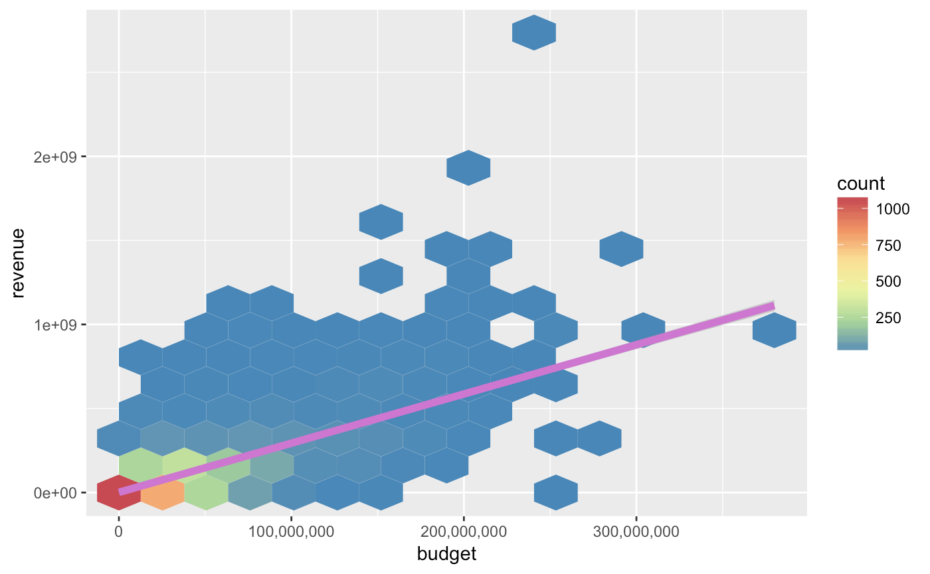
Comparing Revenue & Budget
This model is needed because there is not a perfect correlation between Budget and Revenue. Large investments risk large flops.
Miracle
Blockbuster
Normal
Flops
Notes:
Raising budget a certain amount does not always give revenue increase in the same amount.
Other factors affect success / flop.
It’s possible that a large investment comes with a large flop

Slide 12
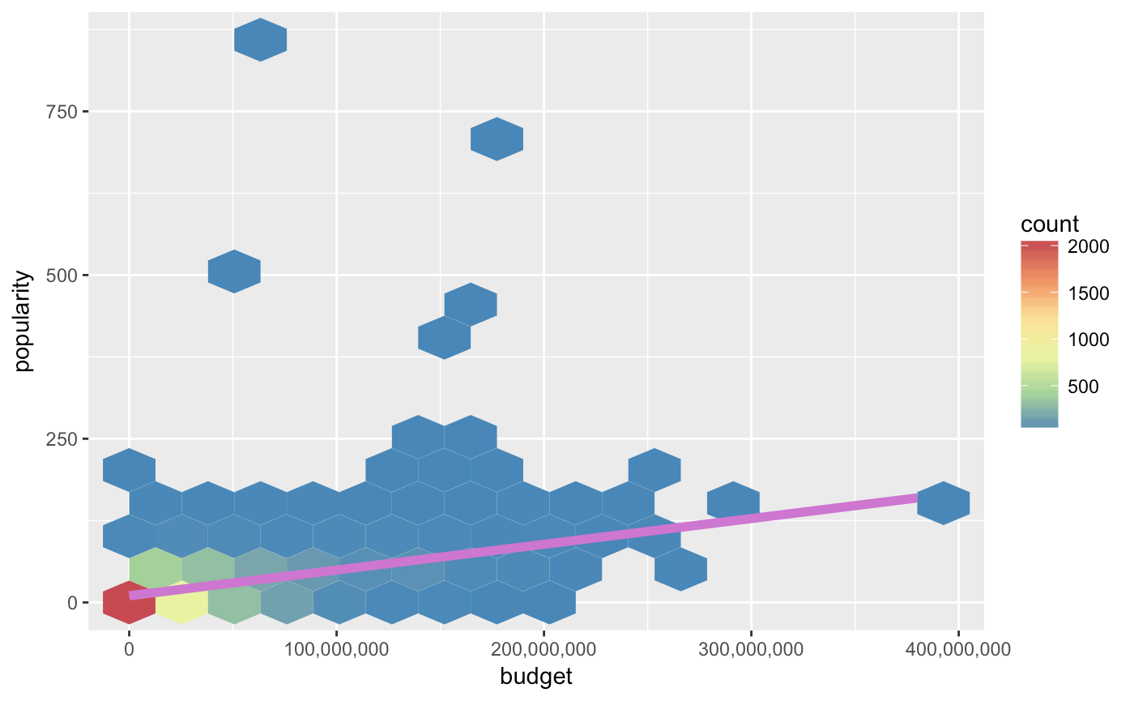
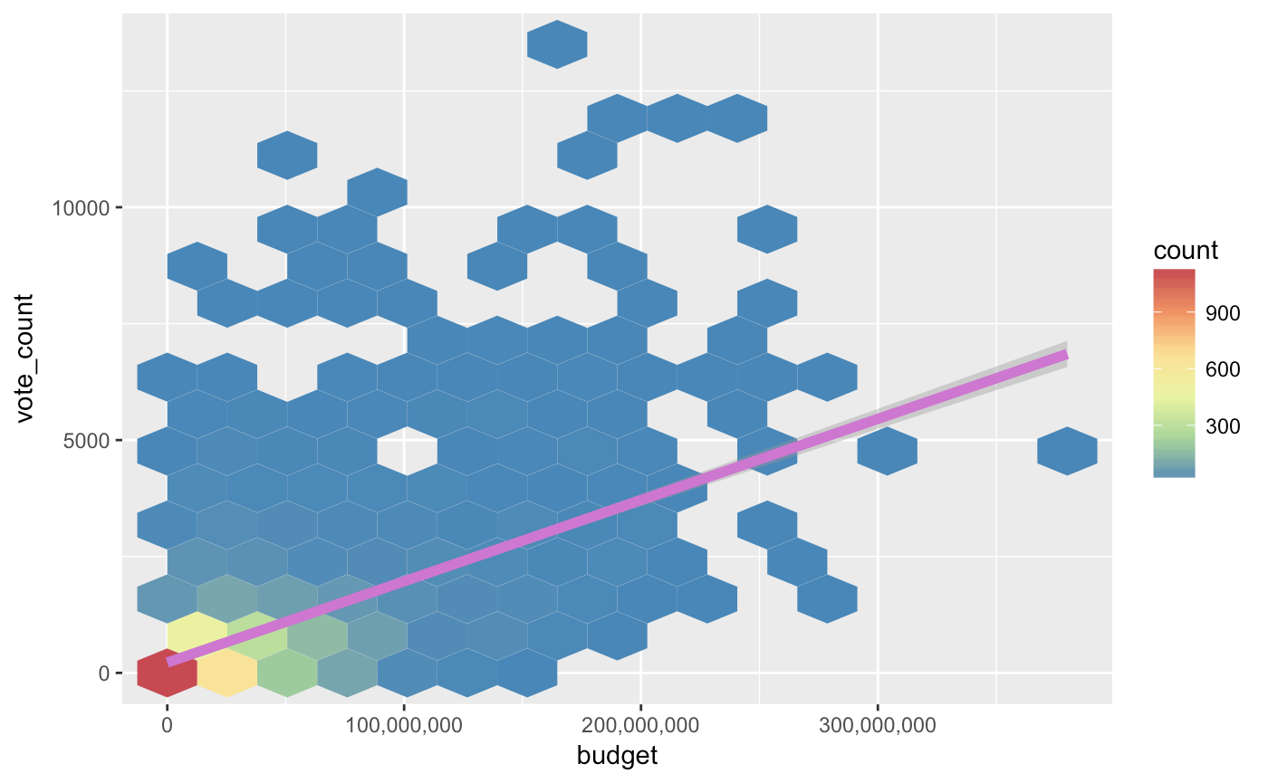
Comparing Budget with popularity and vote_count
Notes:
Budget vs popularity
Budget vs vote count
Raise in budget doesn’t not necessarily give your movie more publicity

Slide 13
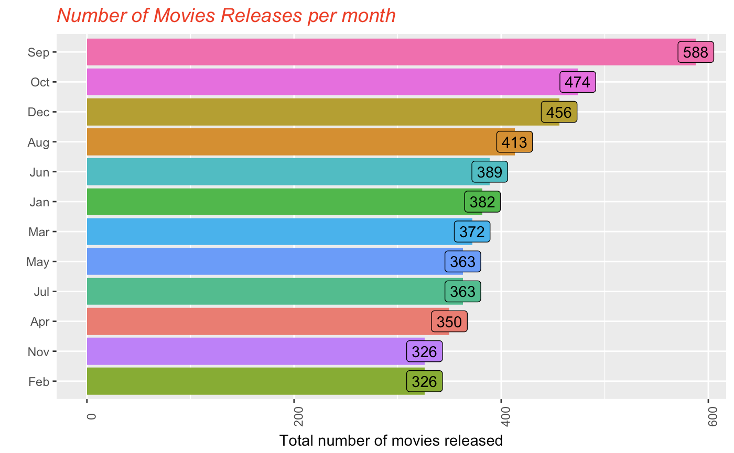
Which month has seen maximum release of movies ?

Slide 14
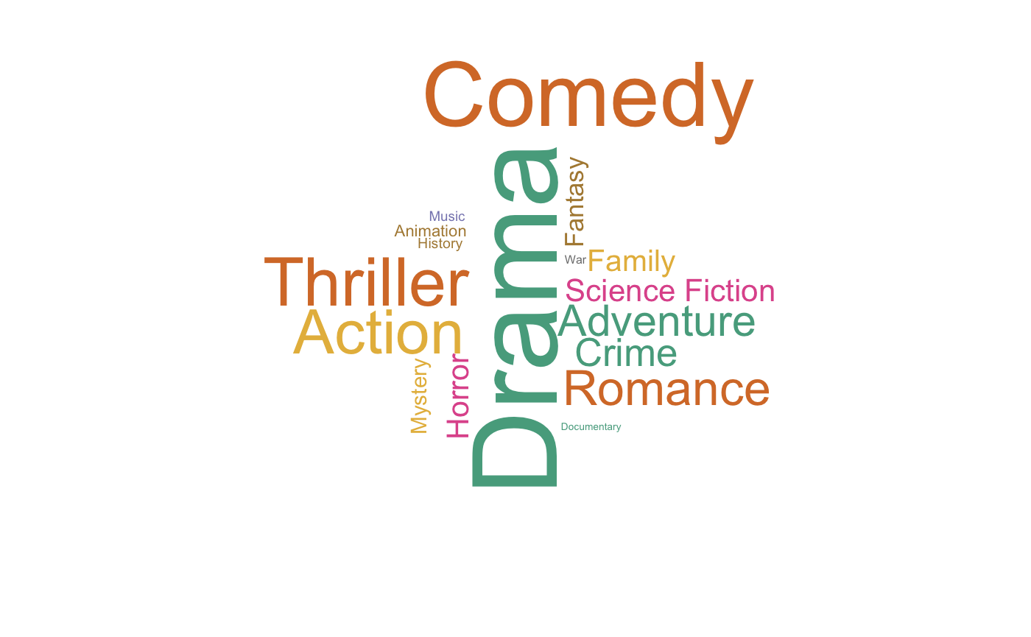
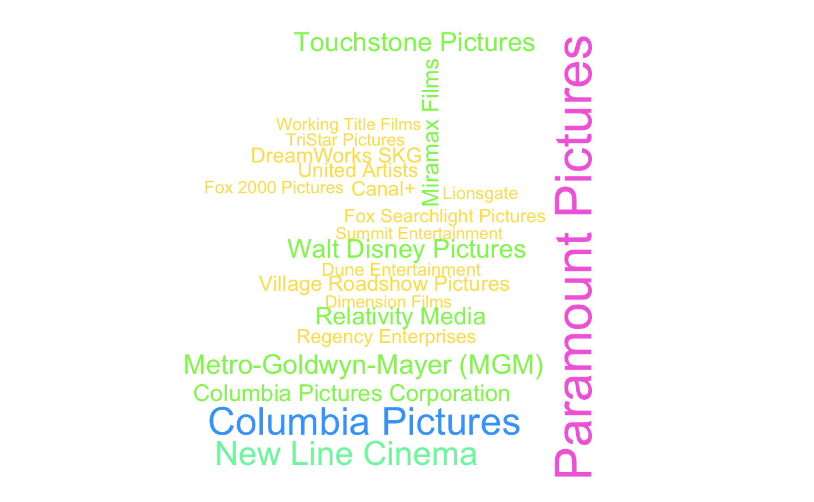
Genres - Word Cloud
Production Company - Word Cloud
Notes:
Frequency of word appearance
No one production company dominates another company

Slide 15
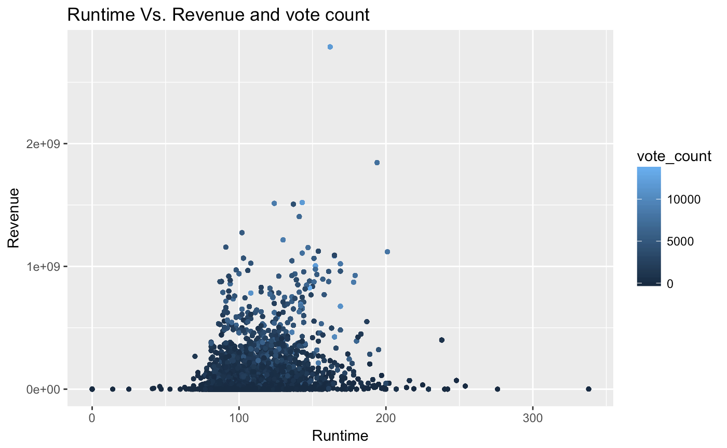
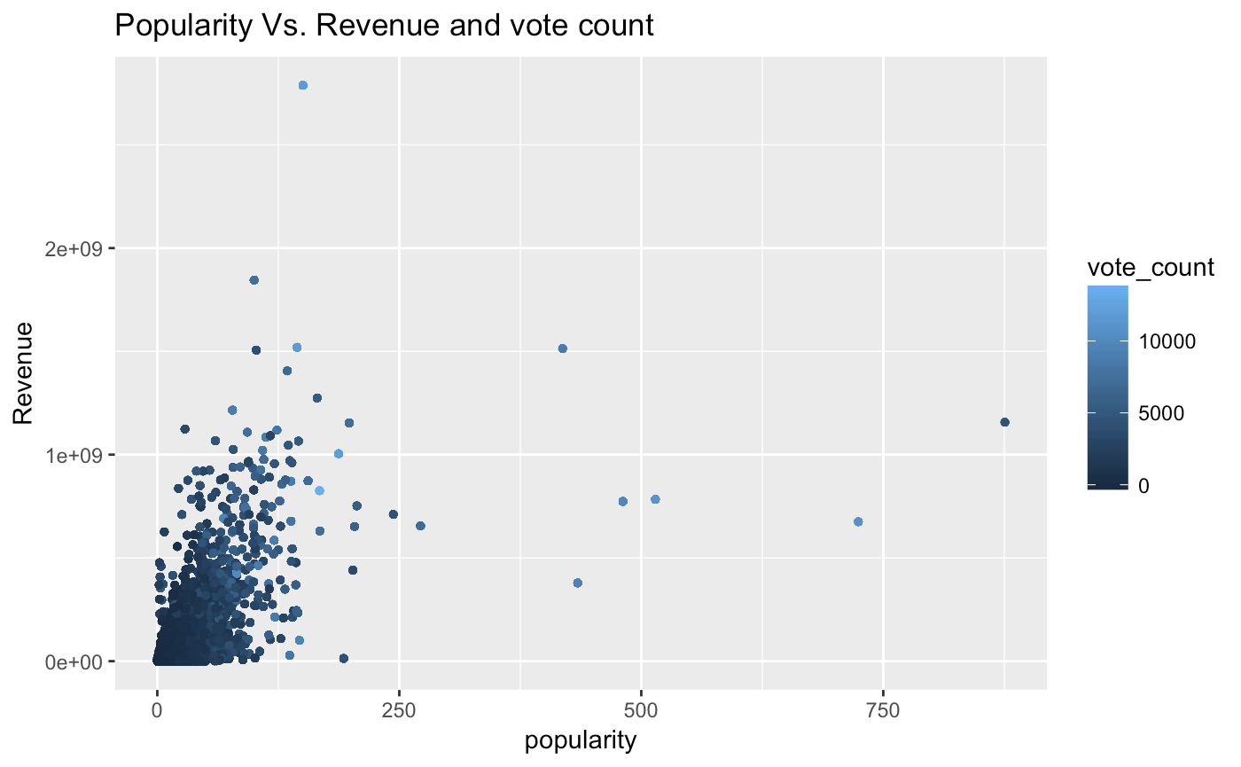
Compare Revenue and vote count with runtime and popularity

Slide 16
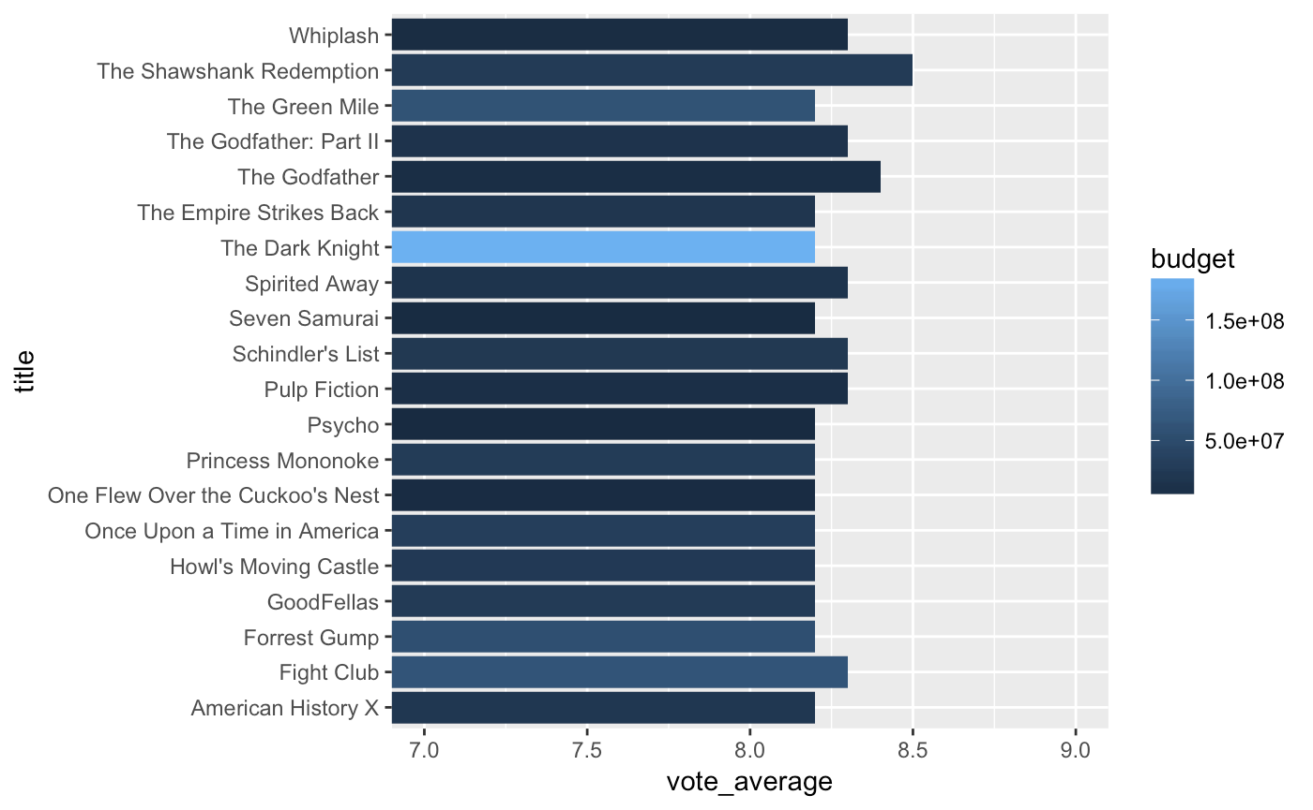
Popularity vs Budget are not highly correlated

Slide 17
Predictive Modeling

Slide 18
Approach
Models used to start our exploration:
Linear regression
Lasso regression
Ridge Regression
Regression Trees
Random Forest

Slide 19
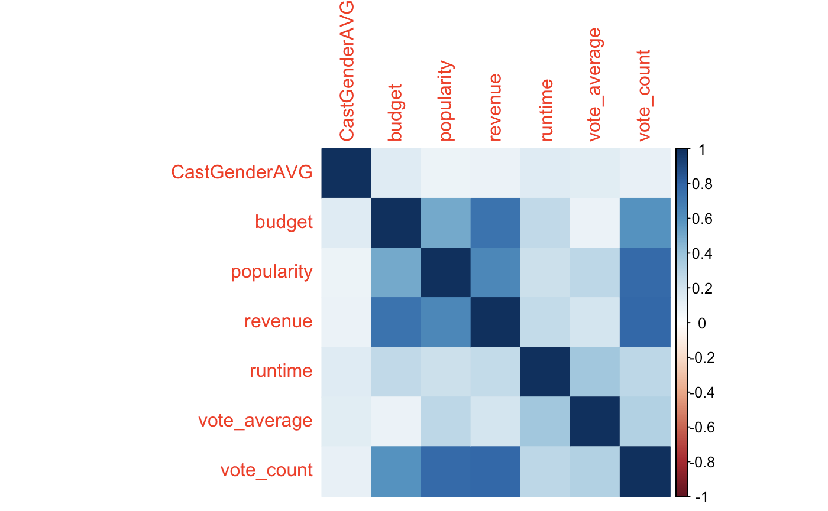
Correlation plot

Slide 20
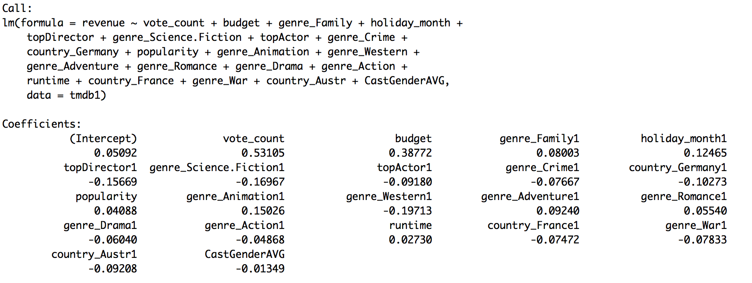
Top Predictors based on forward and backward selection

Slide 21
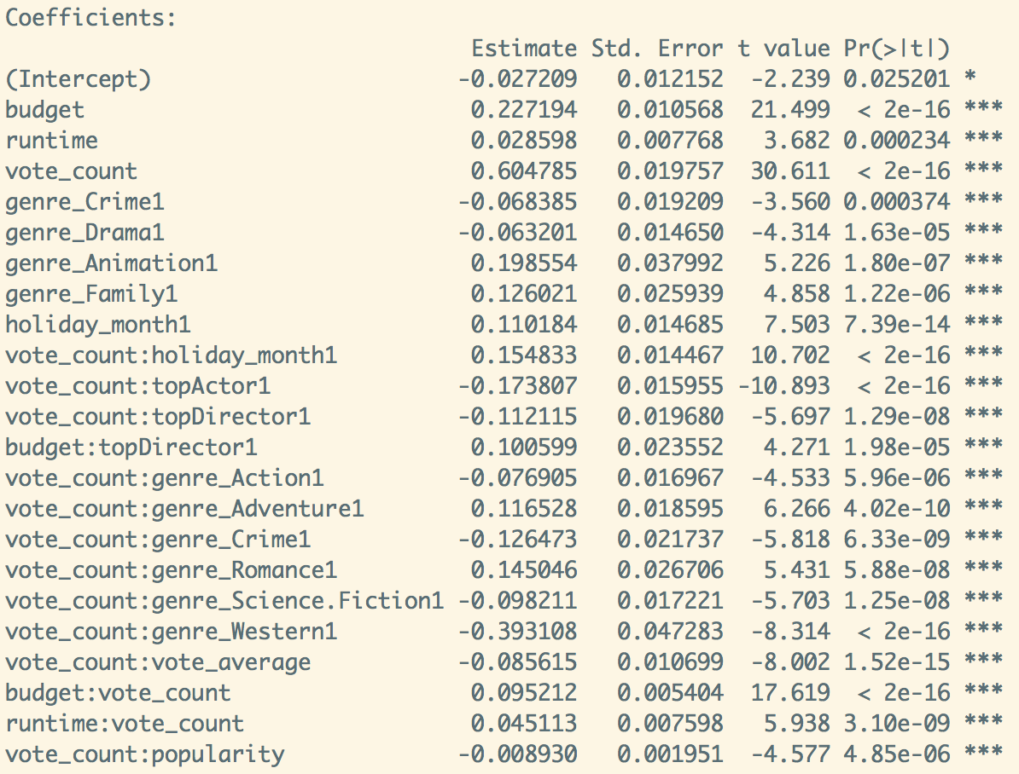
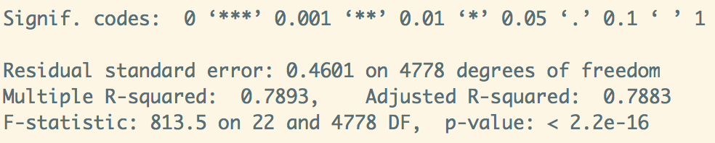
Linear Regression

Slide 22
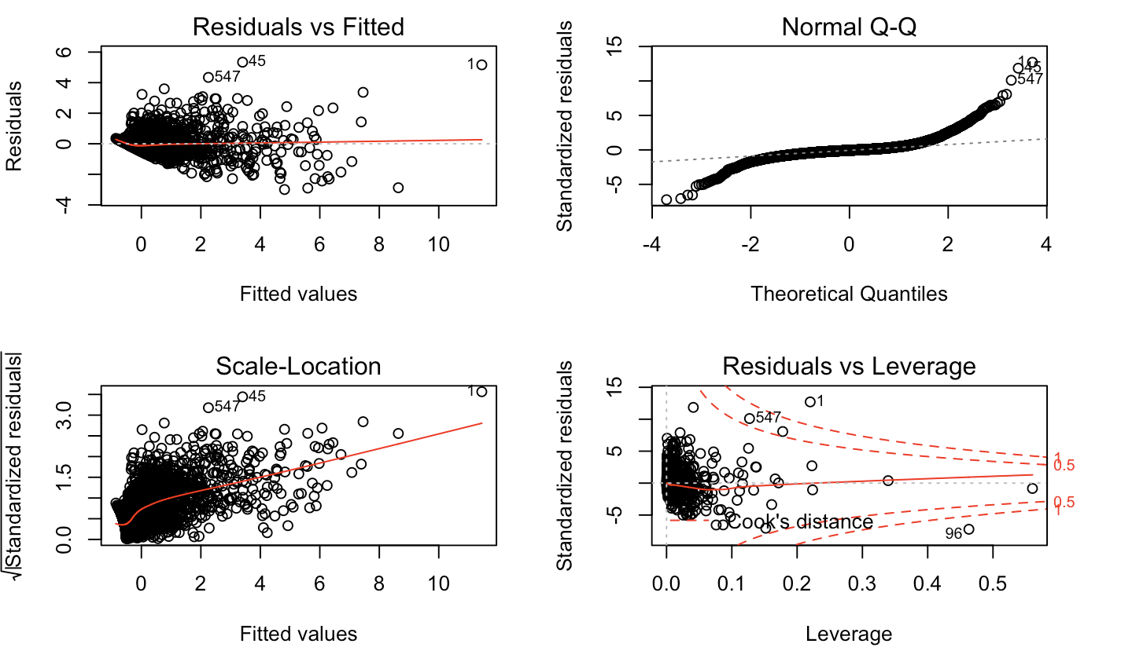
Plots on LM

Slide 23
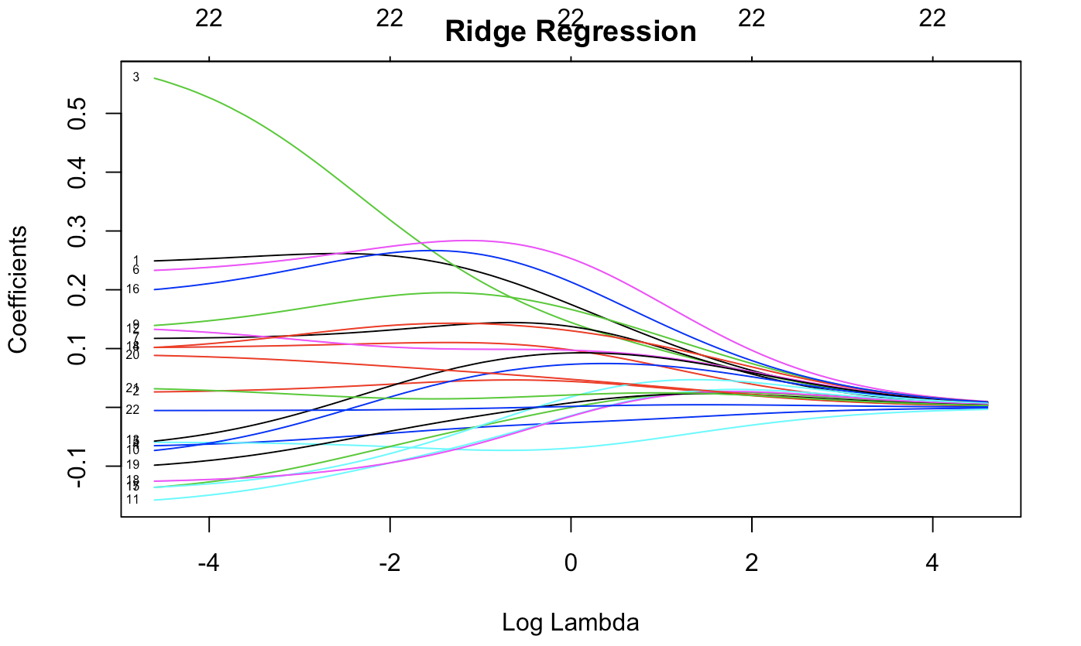
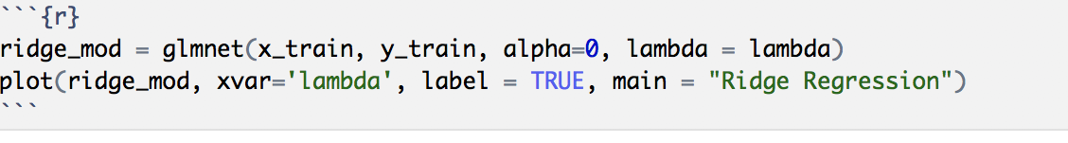
Ridge Regression

Slide 24
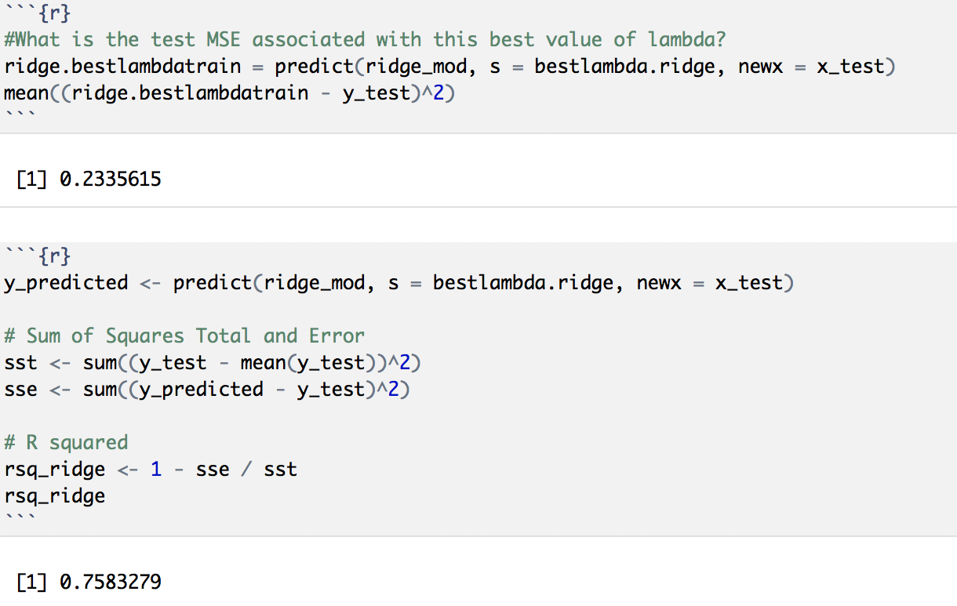
Ridge Regression

Slide 25
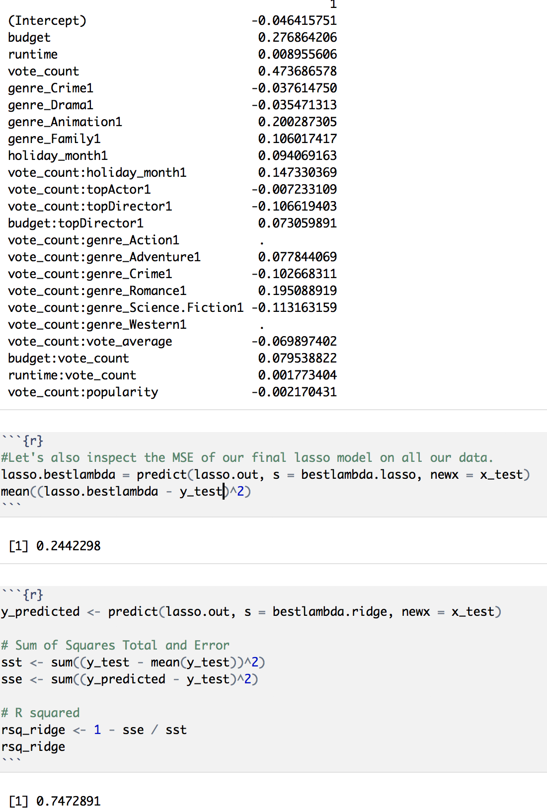
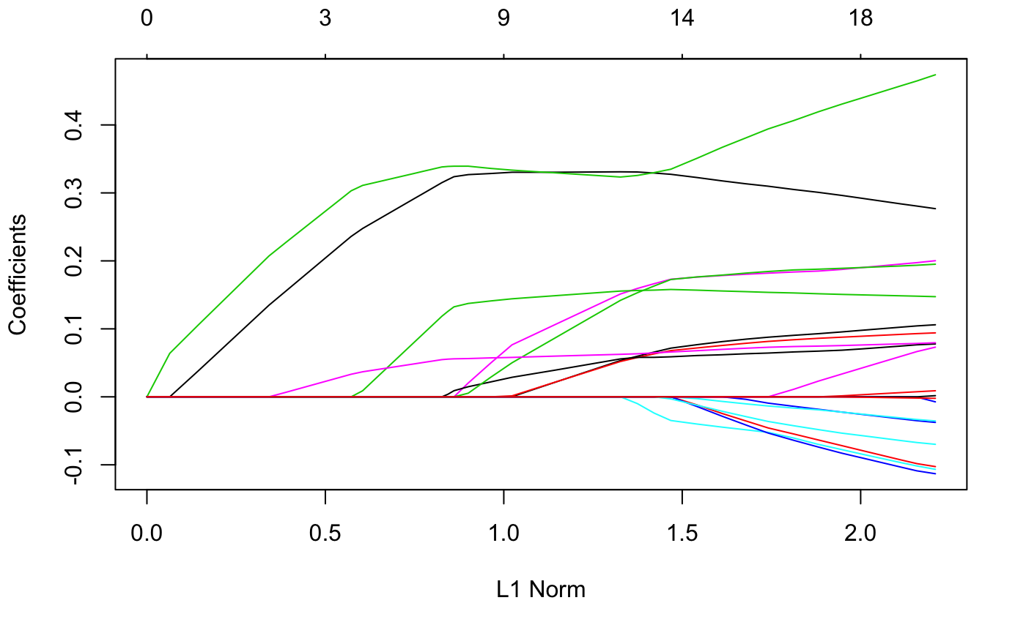
Lasso Regression

Slide 26
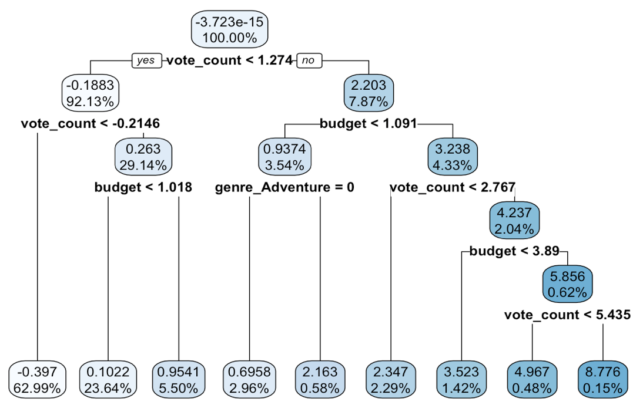
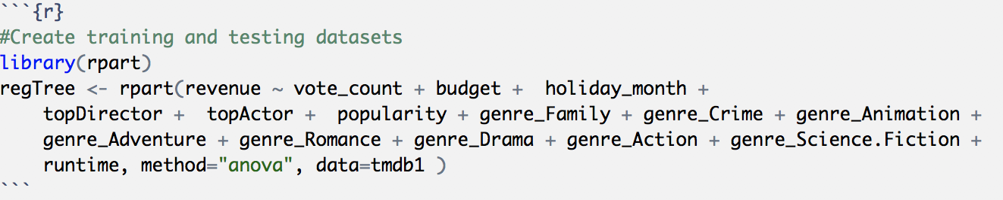
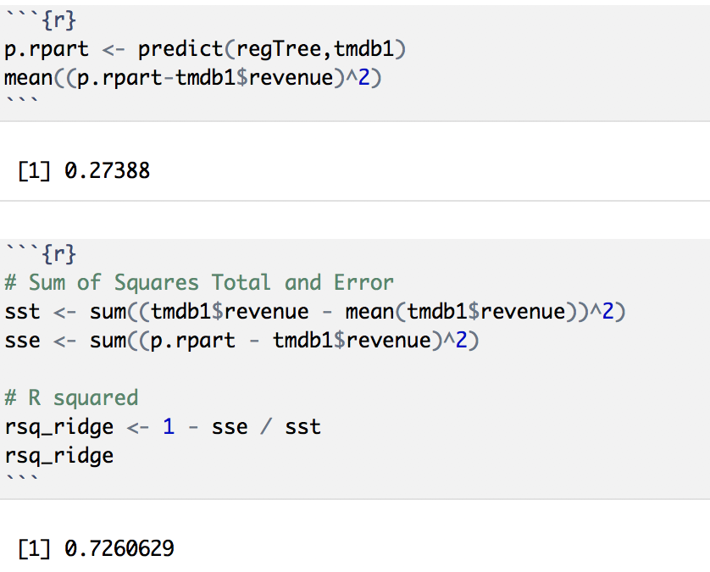
Regression Trees

Slide 27
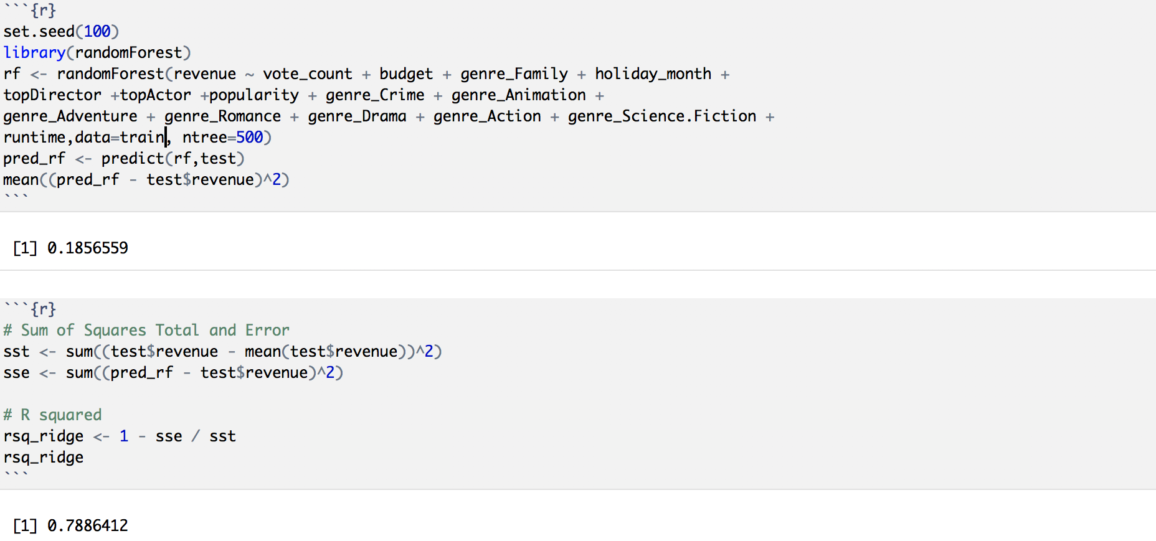
Random Forests

Slide 28
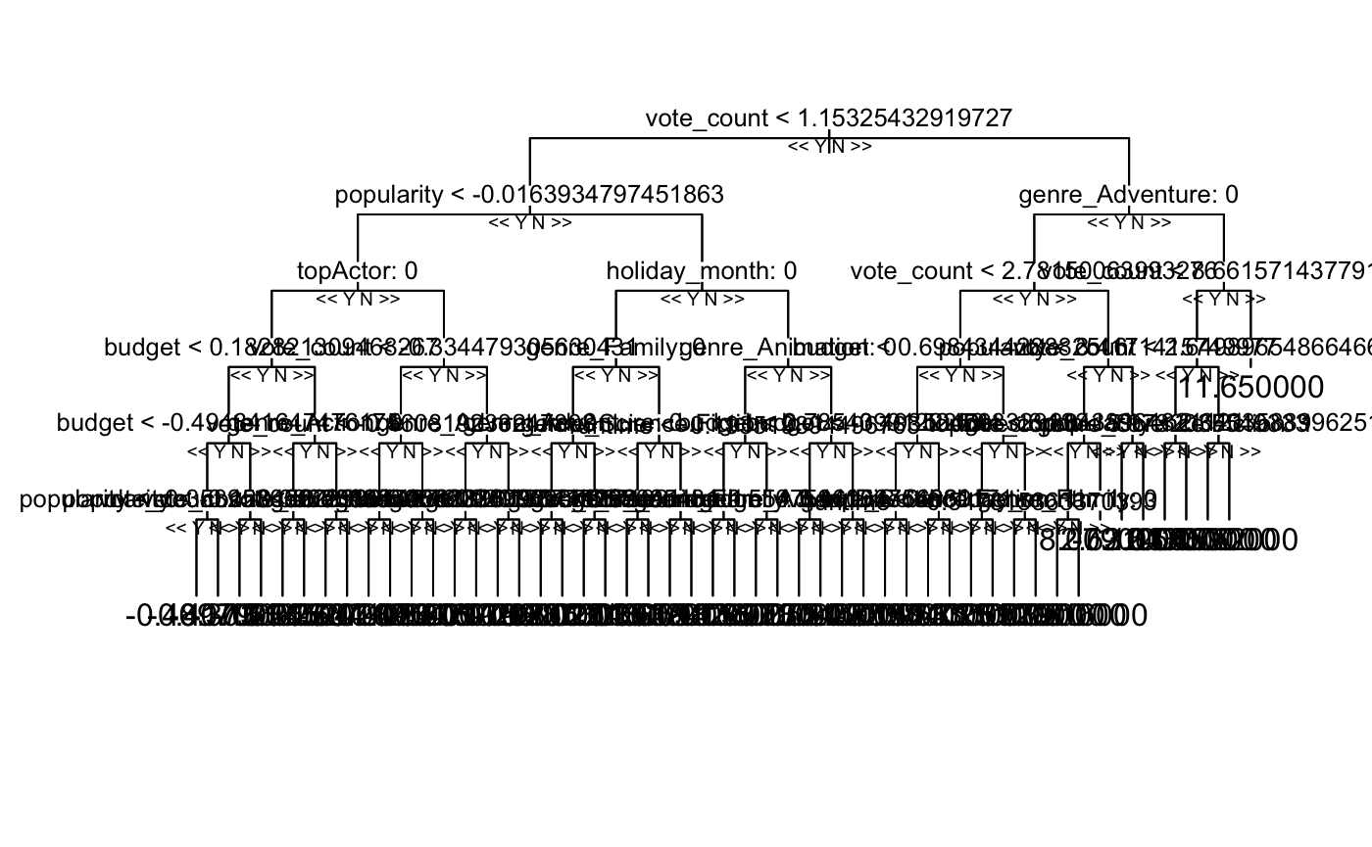
Random Forests

Slide 29
79% Accuracy
Based upon testing on several models our best model was Random Forest with 79% Accuracy on test data

Slide 30
Conclusion
Leveraging the developed model
Production companies can make more insightful decisions on whether to fund a film.
References:
https://www.themoviedb.org/
https://drsimonj.svbtle.com/ridge-regression-with-glmnet
https://www.r-bloggers.com/ridge-regression-and-the-lasso/
https://www.r-bloggers.com/random-forests-in-r/

Slide 31
The End / Q&A

Slide 32
Backup Slides

Slide 33
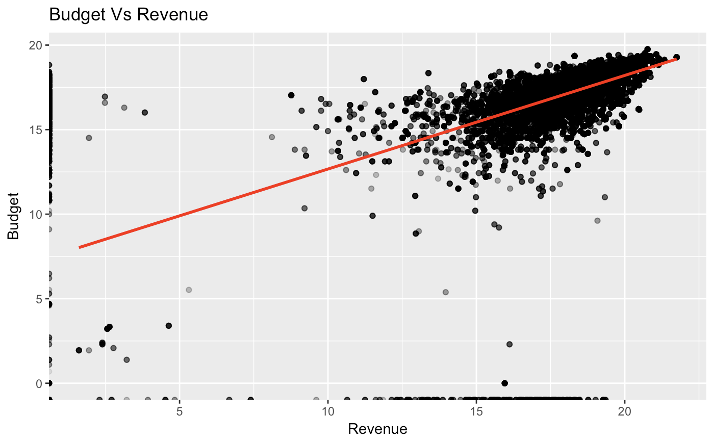
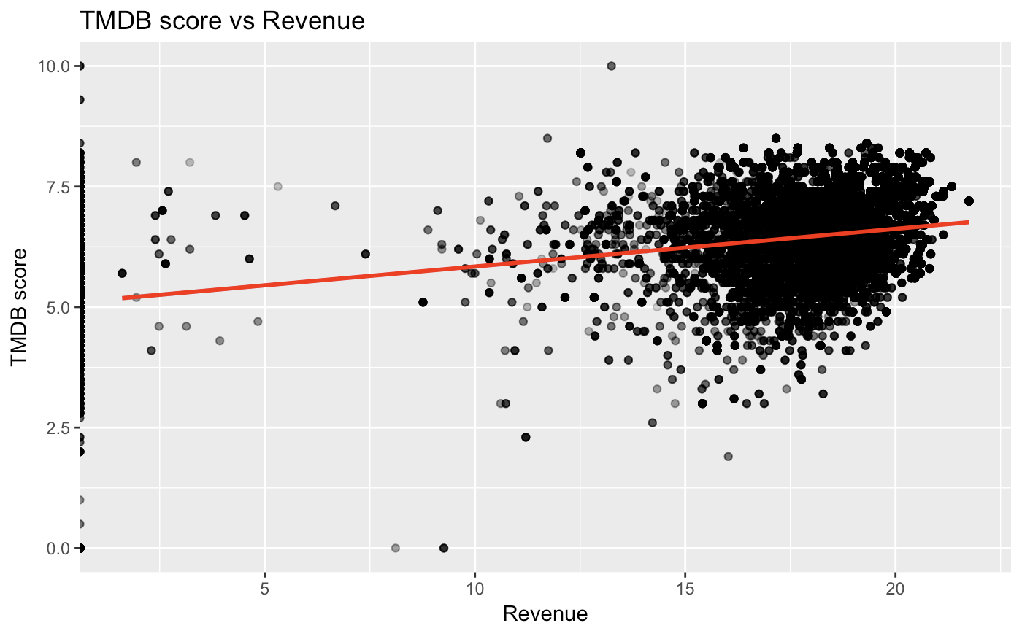
Revenue vs Budget & TMDB score

Slide 34
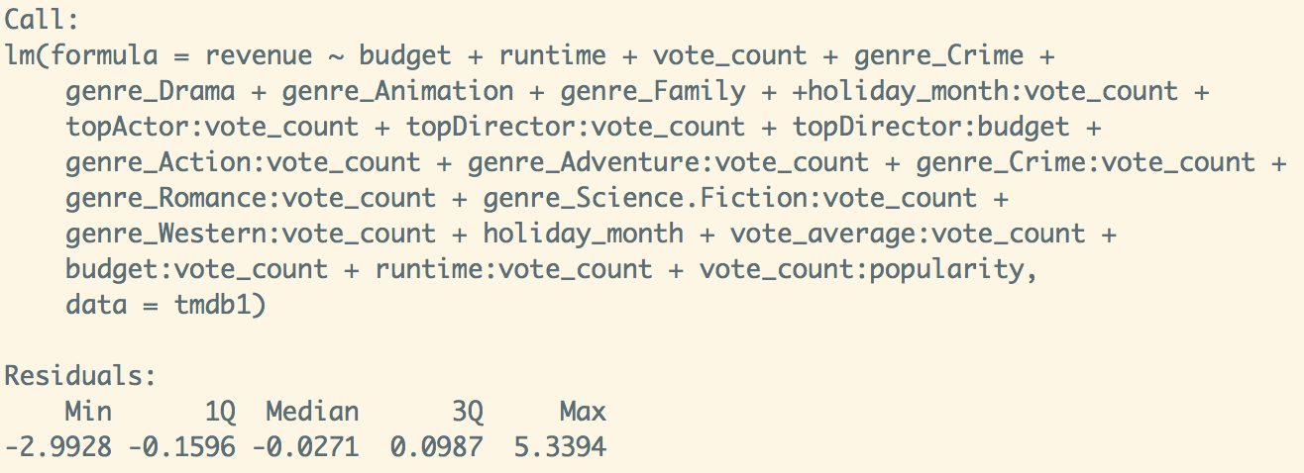
Linear Regression

Slide 35
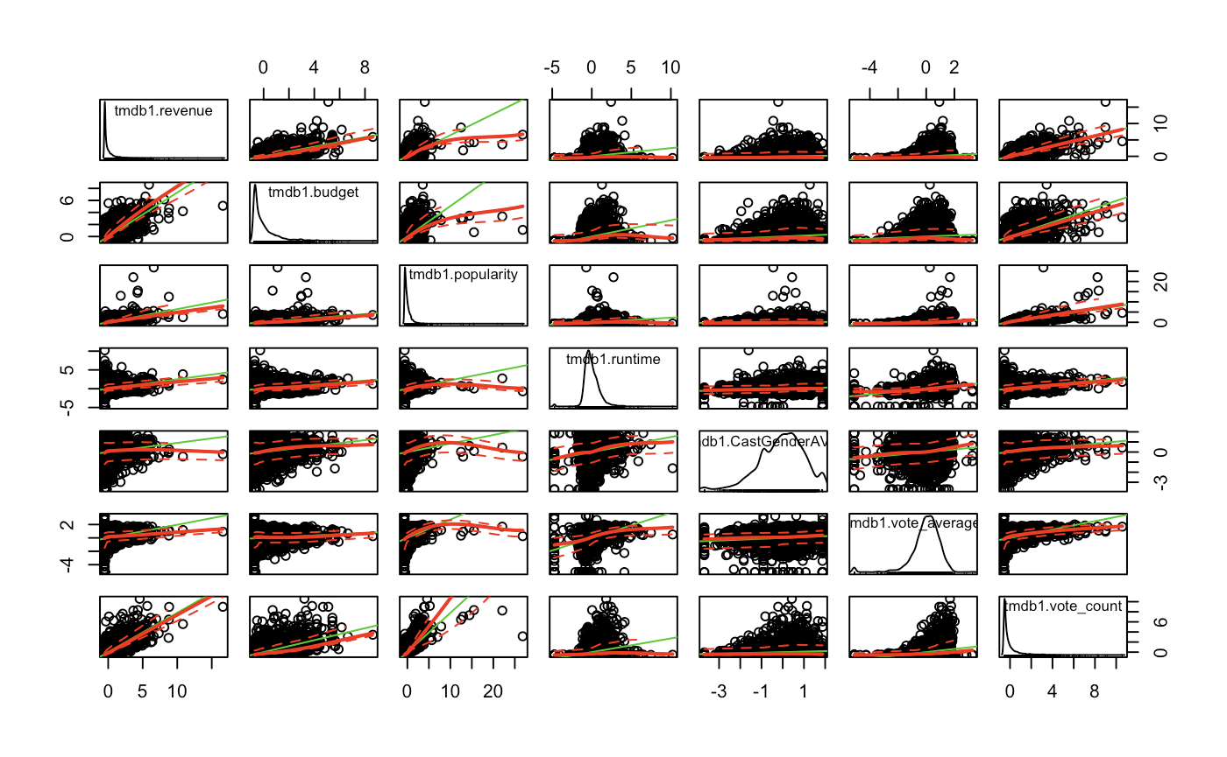
Scatter Plot for the Numeric Variables

Slide 36
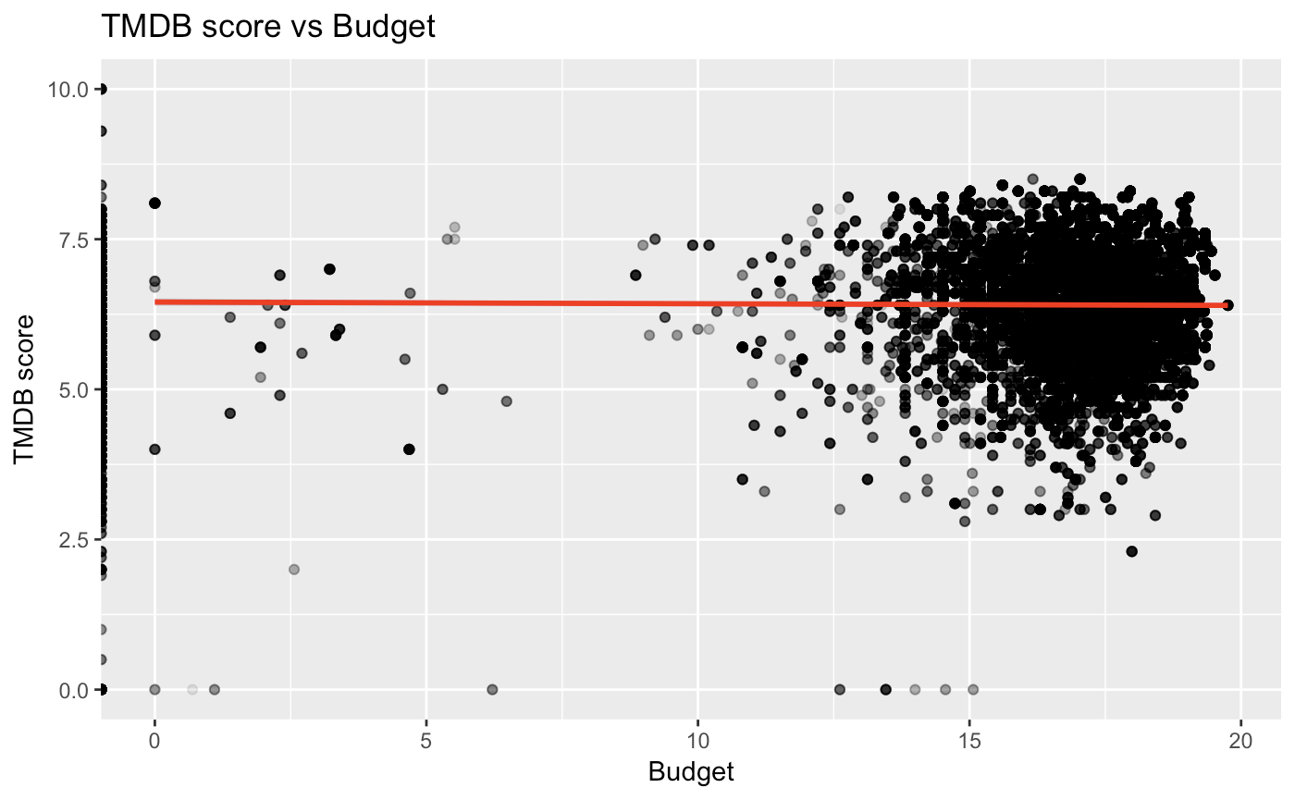
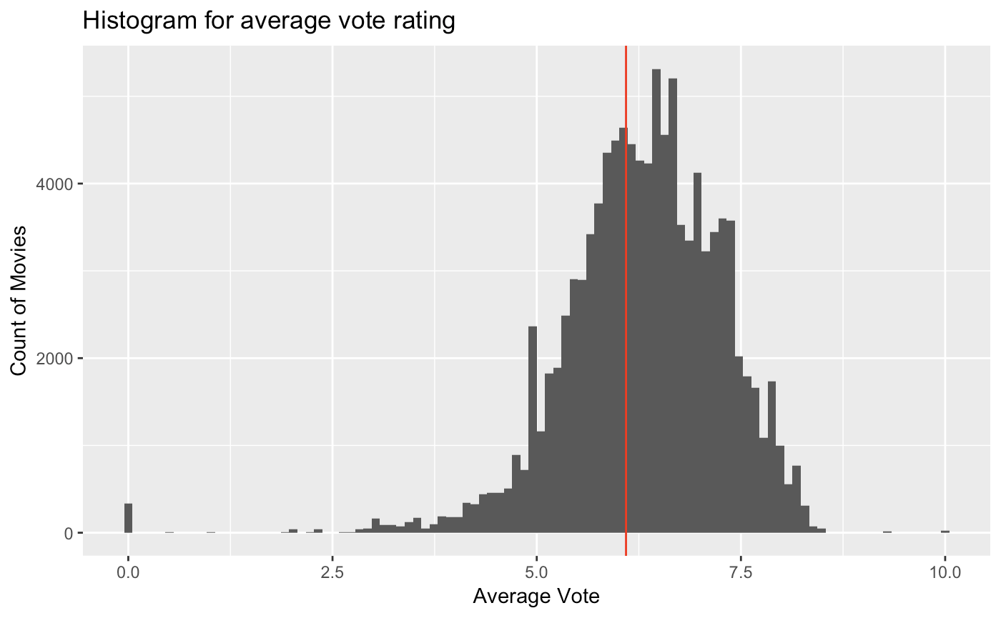
TMDB score vs Budget
Average voting

Slide 37
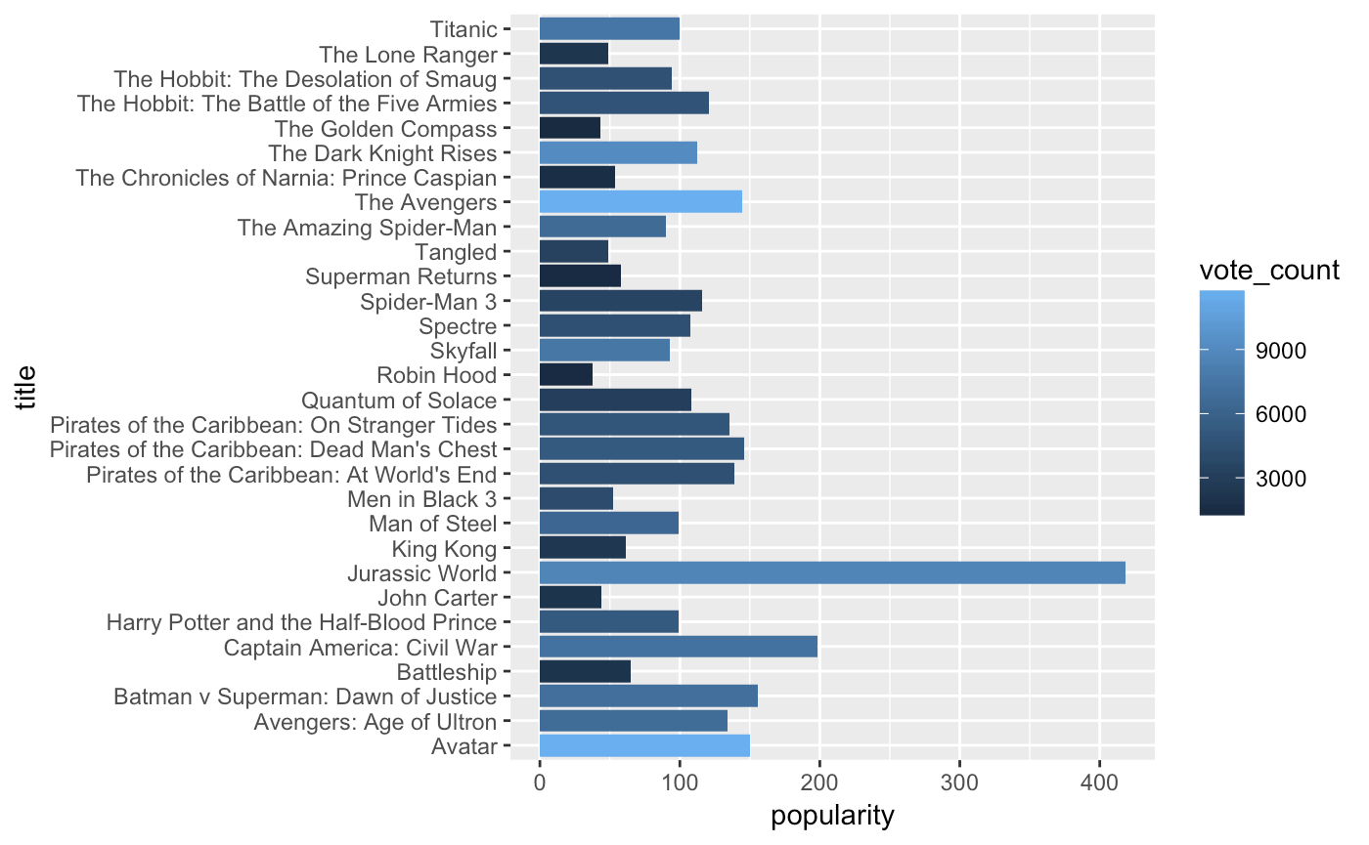
Title vs popularity & vote count

Slide 38
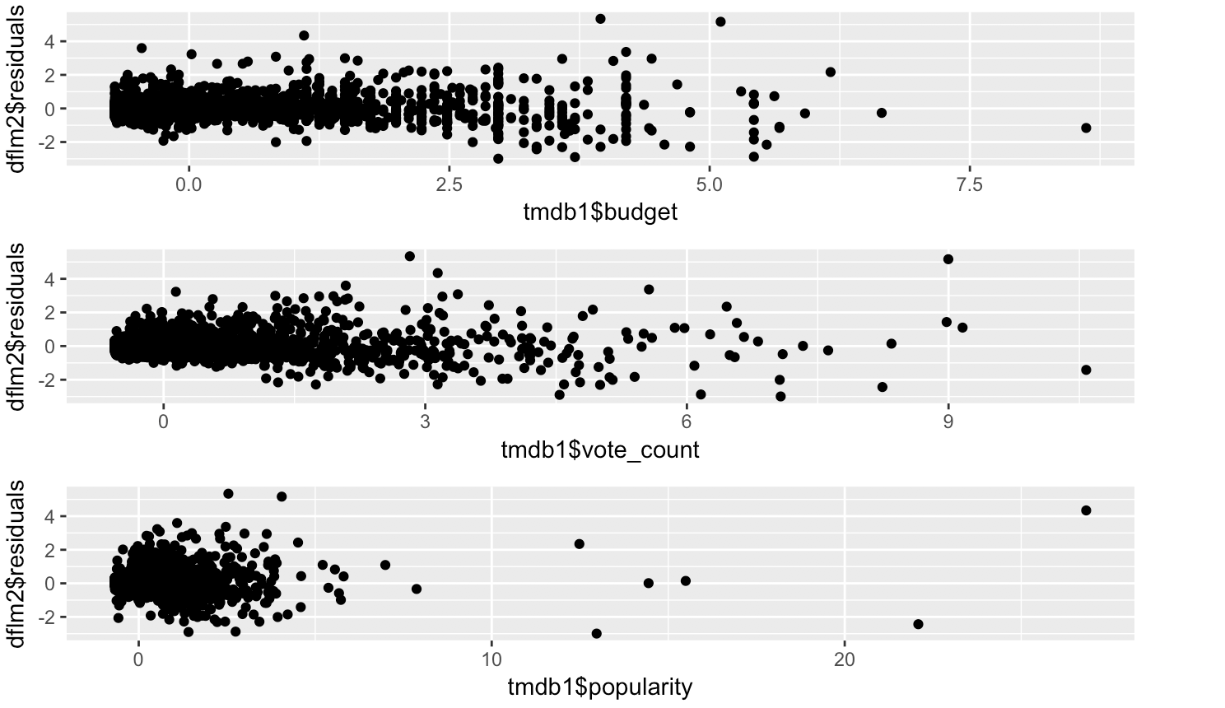
Residual plot on budget, vote_count & popularity

Slide 39
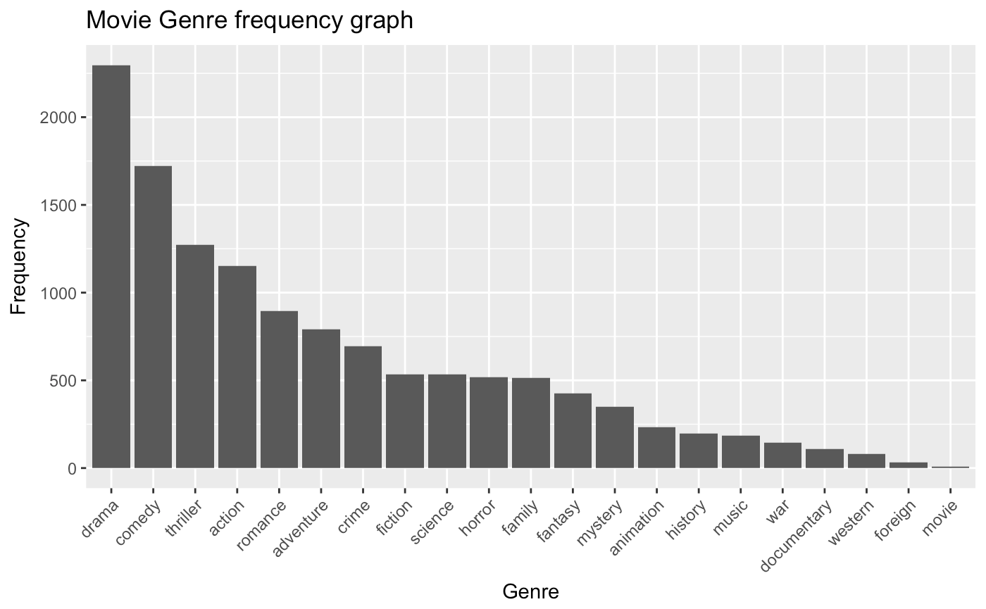
Genre vs Frequency

Slide 40
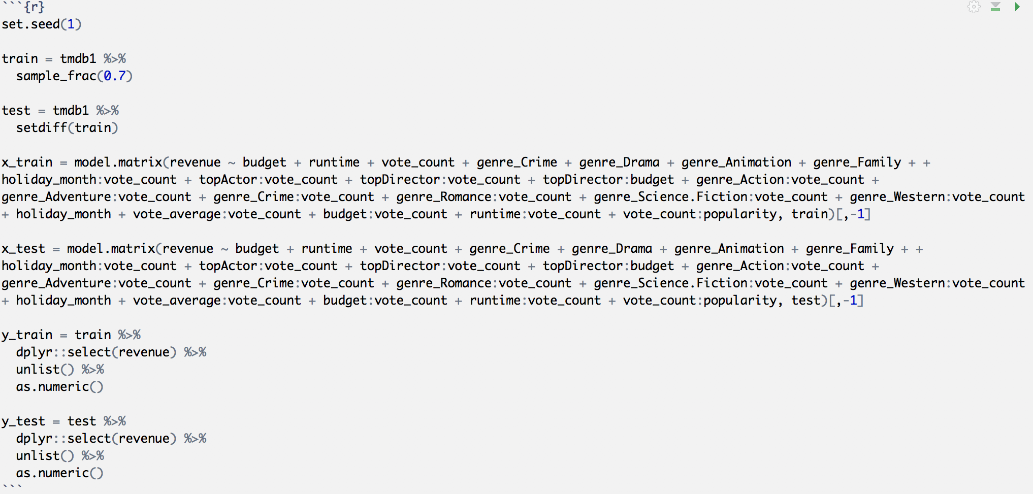
Test and Train dataset

Slide 41
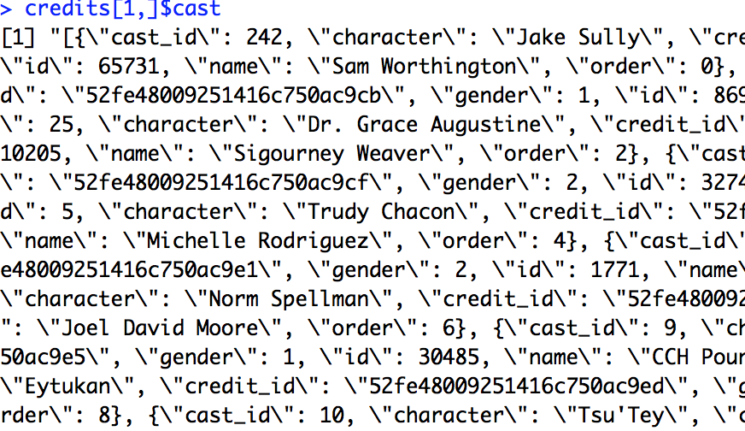
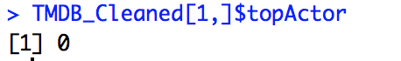
Normalizing Cast & Crew
From the nested JSON, we determined if the cast & crew contained top 100 Actors & Directors. Data obtained from IMDB.

Slide 42
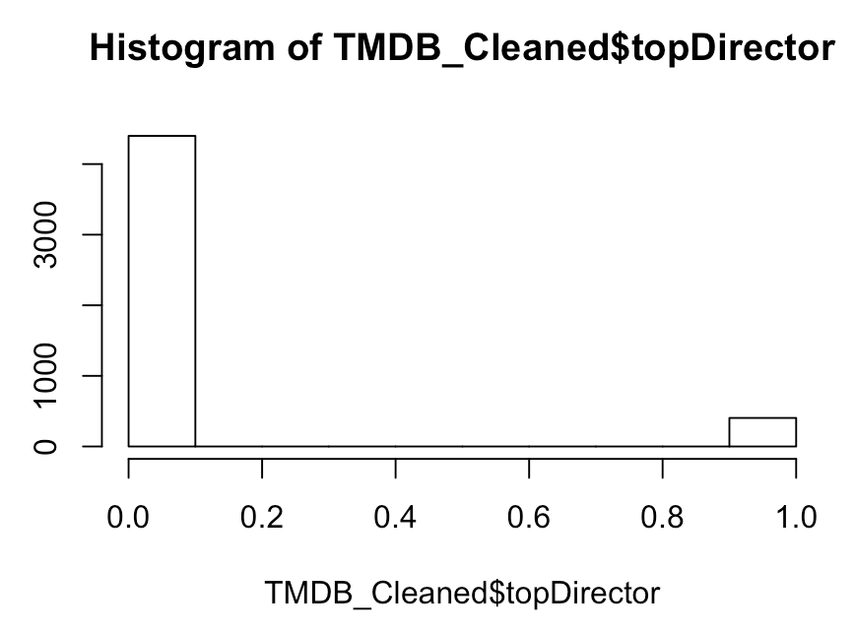
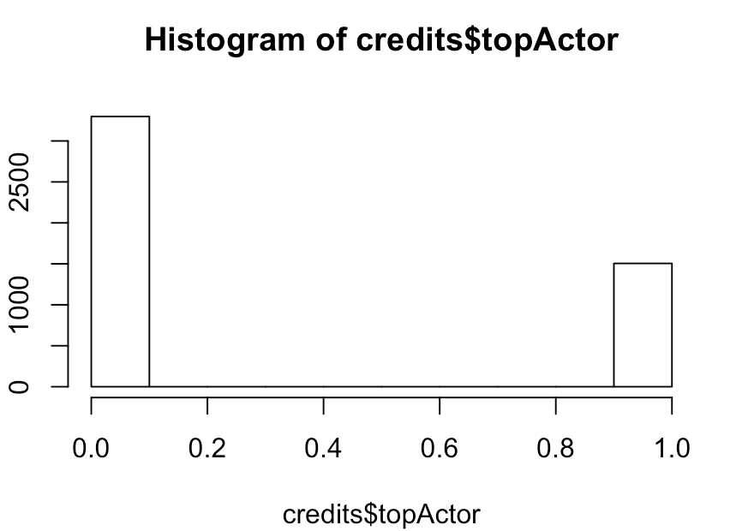
Breakdown of top Actors & Directors

Slide 43
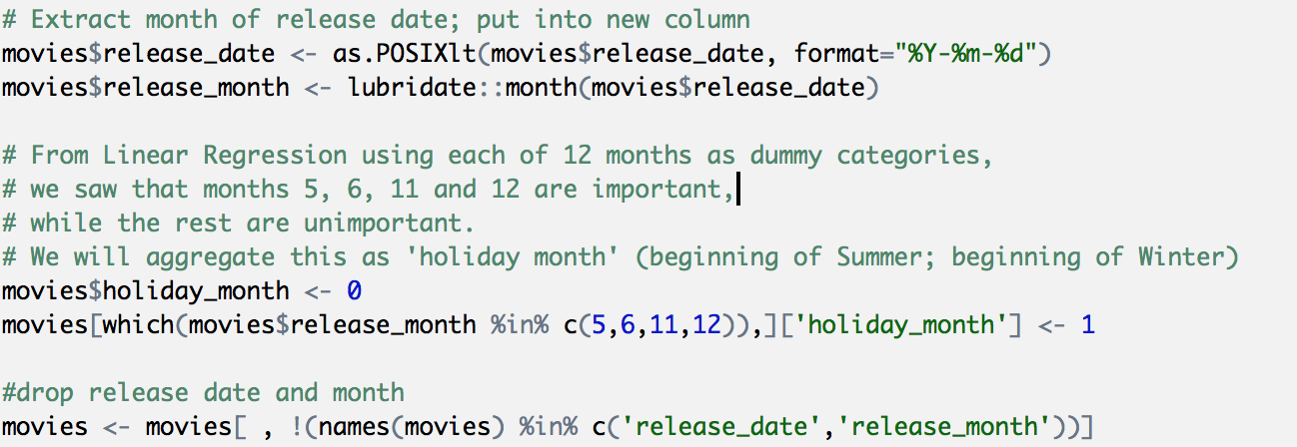
Clean Up Process - Normalizing Dates

Slide 44
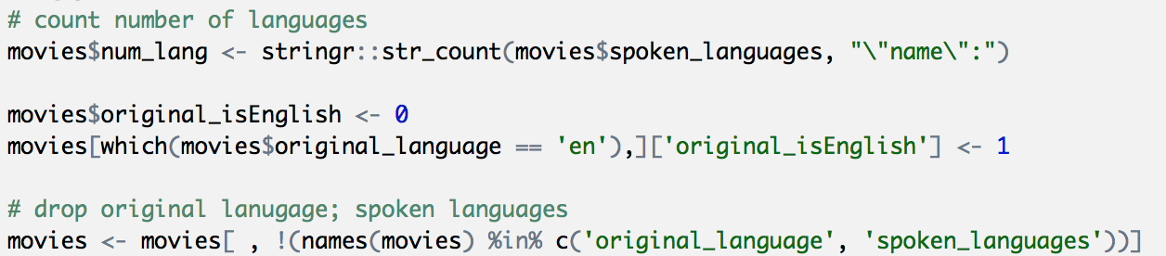
Clean Up Process - Language

Slide 45
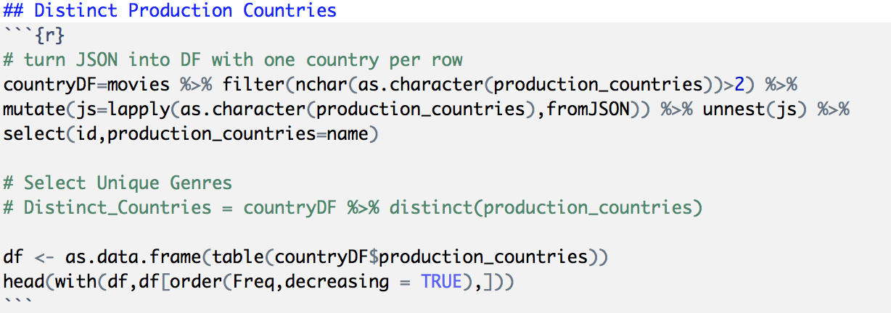
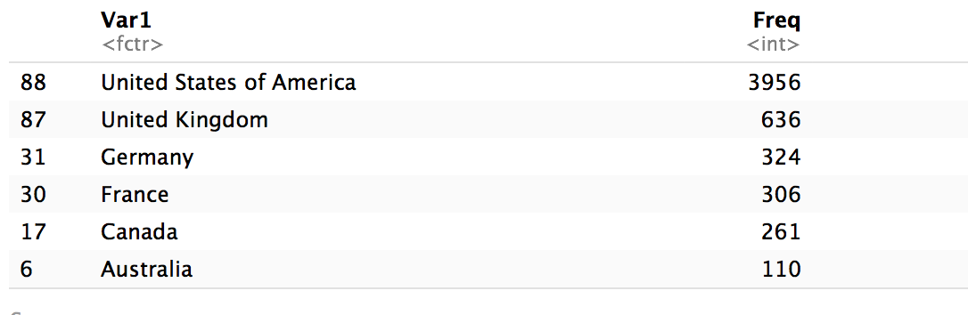
Clean Up Process - Production Location

Slide 46
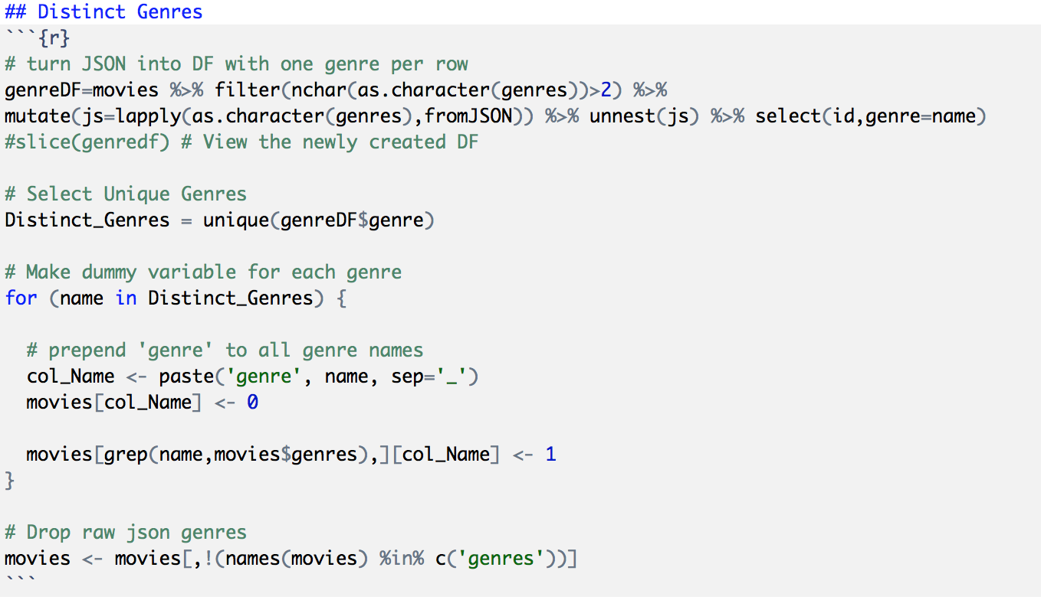
Clean Up Process - Distinct Genres

Slide 47
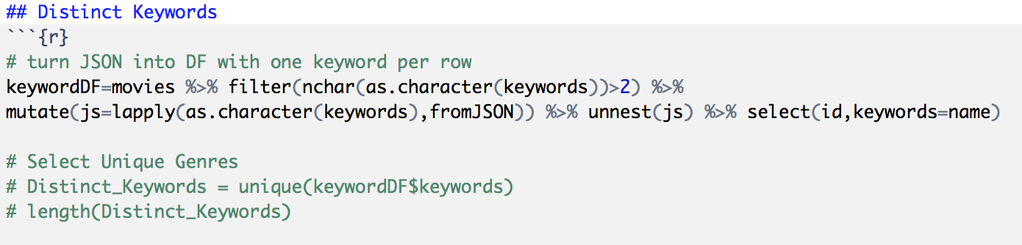
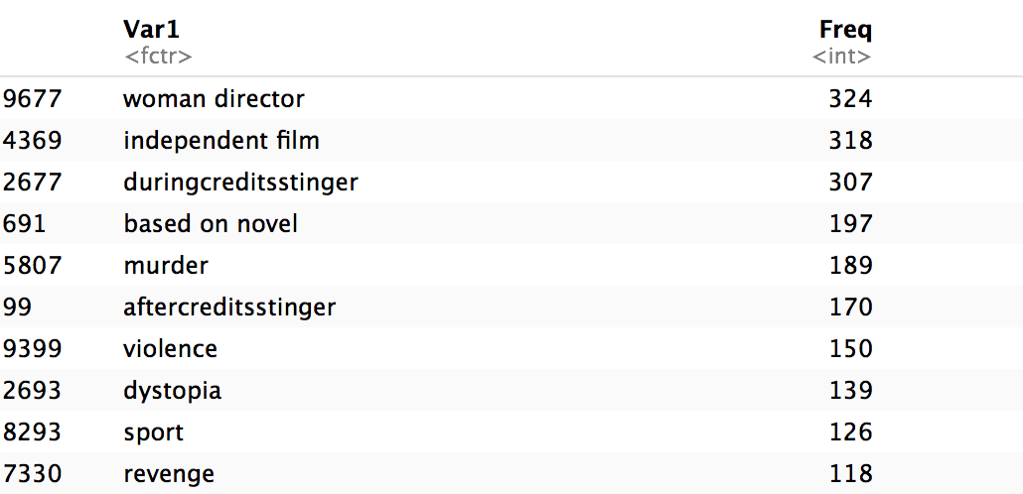
Clean Up Process - Distinct Keywords

